Slide 1
Shortage Annex
Supply holds the official shortage annex for any item in the Company
Hand receipt holders will be responsible to create new copy during inventories pre inventories, matching standard (next slide)
Any changes from initial Shortage annex will be reconciled accordingly
Shortage Annex is not official unless signed by the CDR

Slide 2
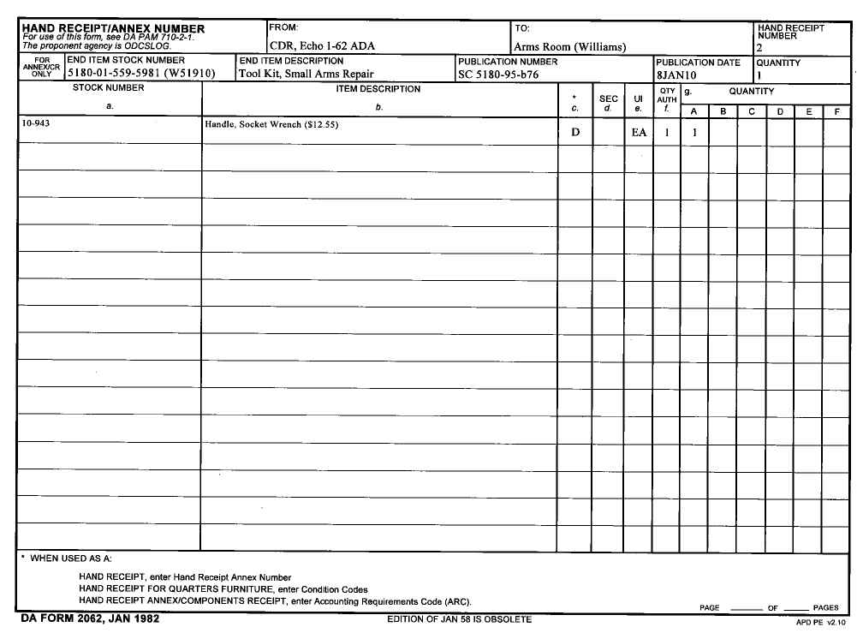
Item Nomenclature
Item NSN & LIN
From: CDR
To: Section and Name
HR number
How many of item are on HR
Component NSN/Part Number
Total: $12.55
Total Missing
Component Nomenclature with FEDLOG Price
Total Authorized across all items
Pub # and Date
Unit of Issue (EA, BX, RO ECT…)
Total Shortage Costs
ARC Code
(X,D,N)

